Slide 1
ME 609
OpTIMISATION METHODS IN ENGINEERING
Project Stage - 1
Nikhil Panse - 160103081 Dyuman Joshi - 160103029

Slide 2
Algorithm steps
Bounding phase method is a direct-search method which brackets the minima into an interval. It is computationally less expensive but also not very accurate.
Coupled with Secant method, which is a region-elimination method, the algorithm can produce accurate results. Secant method is a gradient search method in which gradient of a function is assumed to be vary linearly between two boundary points. It is computationally expensive than bounding phase.
In this algorithm, the two boundary points are obtained from bounding phase method which helps in more accurate and faster convergence.

Slide 3
Code Format
Main Function : Calls the below mentioned functions Input : x0 - Initial guess for bounding phase method Output : (a, b) - interval in which minima value lies, z - minima, z1 - function value at minima.
Bounding Phase method function : (delta = 0.001) Input : x0 - Initial guess, del - delta value , funcName - function Output : (a ,b) - interval in which minima value lies
Secant Method function : Input : (a, b) - From BoundingPhase function, funcName - function Output : z - minima, z1 - function value at minima.
Derivative function : (delta = 0.001) Input : value at which derivative is to be calculated Output : value of derivative of function at x
Functions are called from a “funcitons” file in the main function.

Slide 4
Example : Min F1(x) = x^3 + 5*x^2 -3 in (-1,1)
Initial guess x0 = 0.5 is passed to the main function. F1(x) is called from ‘funcitons’ file (uncommented function).
Both are passed to bounding phase function along with delta value of 0.001 Bounding Phase function output : (-0.5220, 0.2460)
The above interval is passed to secant function, which also has derivative function built inside Secant function output : Minima at x = -0.0420 Actual minima at x = 0

Slide 5
Example : Max F3(x) = 8+ x^3 -2x -2*exp(x) in (-2,1)
Maximisation problem is converted to minimisation problem by the duality principle.
Initial guess x0 = -1
Bounding phase output : (-0.01, -1.546)
No of iterations : Bounding phase = k =9 Secant method = 7
Minima at x = 0.9601
Bounding phase
Iteration | Value of x(k)
1 | 0.4940
2 | 0.4860
3 | 0.4700
4 | 0.4380
5 | 0.3740
6 | 0.2460
7 | -0.0100
8 | -0.5220
9 | -1.5460
Secant
Iteration | Value of z
1 | -0.7107
2 | -0.9080
3 | -0.9499
4 | -0.9582
5 | -0.9598
6 | -0.9601
7 | -0.9601

Slide 6
Observations
If the initial guess is closer to the minima the final output of secant function is much closer to the actual minima.
Delta value for calculating gradient should be as small as 0.001
Lower epsilon value for secant method leads to more accurate result but is computationally more expensive.
Very low delta values of bounding phase method gives slower convergence.

Slide 7
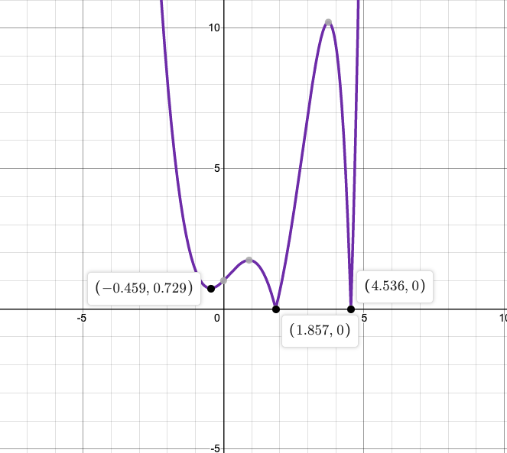
Root - Finding : F10(x) : exp(x) - x^3 = 0
Perform bounding phase method and secant method for abs(F10(x)) and get the minimum value.
Starting with initial guess x0 = 2
Bounding phase output - (1.7460, 1.938)
Secant method output - Minima at x = 1.8307
Hence x = 1.8307 is a root of F10(x) = 0.

Slide 8
 | (a,b) | Initial guess x0 | Bounding Phase output | Minima by Secant Method | Actual Minima
F1 | (-1,1) | 0.5 | (-0.522,0.246) | -0.0420 | 0
F2 | (-10,0) | -5 | (-2.0460,-8.19) | -5.7751 | -
F3 | (-2,1) | -1 | (-0.01, -1.546) | -0.9601 | -0.96
F4 | (0.5,5) | 1 | (1.2540 ,2.0220) | 1.4310 | 1.431
F5 | (0.5,pi) | 1 | (1.510, 3.046) | 1.9258 | 2.029
F6 | (-2,3) | 1 | (1.2540,2.022) | 1.4579 | 1.591
F7 | (0,4) | 3 | (2.746,2.9380) | 2.8350 | 2.838
F8 | (-6,6) | -1 | (-0.490,1.046) | 0.5271 | 0.527
F9 | (-4,4) | 1 | (-0.022,0.746) | 0.5376 | 0.564
F10 | - | 2 | (1.7460, 1.938) | 1.8307 | Root at 1.857

Slide 9
Thank you

